Slide 1
A Taste of Fisheries Science Lecture 5: Stock Assessment Models
Dr. Heather Bowlby and Dr. David Keith
Fisheries and Oceans, Canada

Slide 2
Quick reminder of what we are trying to do
What are the objectives of traditional Fisheries Science?
In the area you want to go fishing, how many fish are there?
Should be we happy or worried about this number?
How many can you sustainably (optimally) remove via a fishery?
How do we achieve this objective?
In theory, it’s pretty simple…
Go out and count your species in the area of interest (Survey – Fishery Independent data).
Go out and count how many fish were removed by the fishery (Fishery Dependent data)
Plug (1) and (2) into a (sometimes) fancy statistical model (Stock Assessment Model).
Figure out what a safe number of fish to harvest is (Precautionary Approach – Reference Points, etc)
Notes:
Four lecture topics are identified by red boxes
- People is in bold because there are direct implications of the science on the people that it impacts.

Slide 3
Step 3: Stock Assessment Modelling
An exceptionally brief introduction
Notes:
Discussion with the group.

Slide 4
Stock Assessment Lingo
Reference points
State Space
Catchability
Virtual Population analysis
Ricker vs
Beverton-Holt
Priors and Posteriors
Catchability
Stock Recruitment
Stock
Bayesians vs
Frequentists
Biomass
Surplus Production Model
Precautionary Approach
Process vs
Observation Equations
Biomass dynamics model
Notes:
Why is this critical for stock assessment? I contend that unlike ecology, the terminology used in fisheries science has specific definitions and these matter when trying to assess a stock. For example:
Is a stock the same as a population? The answer to this will tell you if emigration and immigration can be ignored in your assessment model.
Does a cohort describe biomass?
Is catch composition the same as age structure? No – the catch composition depends on the age structure, but is modified by selectivity
How is F related to U; how is S related to M? Fishing mortality and exploitation are not synonymous and we will tell you why.

Slide 5
What is a stock assessment?
Surprise, it’s complicated!
It is process of determining the status of a stock (population) of interest
The procedure will vary by political jurisdiction
Within DFO it looks something like this
A ‘stock’ is identified in which Science Advice is required to inform the status of the stock
A request is made, often by Resource Management, to provide Science Advice
DFO Science goes… ‘Can we provide this advice?’
If we can’t then Resource Management is informed
‘Sorry folks, it ain’t happening’
This is not an uncommon scenario, the primary reasons are
A lack of staff and/or a lack of data.
Notes:
Four lecture topics are identified by red boxes
- People is in bold because there are direct implications of the science on the people that it impacts.

Slide 6
What is a stock assessment?
If DFO Science agrees to provide Science Advice, then this triggers a whole process
Generally, Science Advice is provided ≈ annually for commercially valuable stocks
The process is organized by the Canadian Science Advisory Secretariat (CSAS)
The results of the process are all publicly available on the CSAS website.
What is this Science Advice?
It comes in all shapes and sizes; we’ll talk about one special case.
DFO Science will collate all available data
Fishery independent data (from survey get biomass, growth, maturity, age, etc)
Fishery dependent data (Landings, bycatch, fishery effort, fishery location, etc)
Time series of indices from the data will be developed along with static indices/parameters
Biomass indices (often by age), weight-length relationships, maturity ogives, aging data, etc
Fisheries landings
Notes:
Four lecture topics are identified by red boxes
- People is in bold because there are direct implications of the science on the people that it impacts.

Slide 7
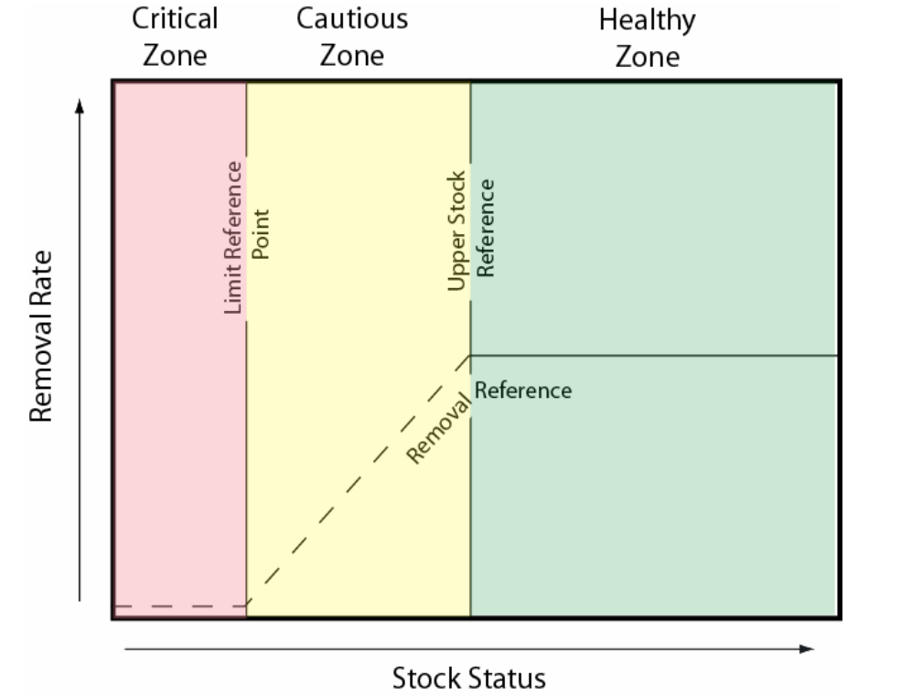
What is a stock assessment?
These data are input into a Stock Assessment Model (SAM)
SAM output is compared to the stock “Reference Points”
Within DFO there are three common Reference Points
Lower (Limit) Reference Point (LRP) – Biomass based usually
The boundary between the cautious and critical zones. When a fish stock level falls below this point, there is a high probability that its productivity will be so impaired that serious harm will occur. The limit reference point is established based on the best available scientific information.
Upper Stock Reference Point (USR) – Biomass based usually
When a fish stock level falls below this point, the removal rate at which the fish are harvested must be progressively reduced in order to avoid serious harm to the stock. The upper stock reference point is also a target reference point that is determined by productivity objectives for the stock, broader biological considerations, and social and economic objectives for the fishery.
Removal Reference Point (RR) – Exploitation based
This establishes the maximum removal rate of fish stocks in each of the zones; progressively decreasing from the healthy to the critical zones. The removal reference is less than or equal to the maximum sustainable yield at which a fish stock can be harvested. This harvest rate must include removals of the stock from all methods (i.e., target, by-catch and other incidental mortality in other fisheries).
Lecture 6 is/was all about this part of the process, so for now we leave it there.
Notes:
Four lecture topics are identified by red boxes
- People is in bold because there are direct implications of the science on the people that it impacts.

Slide 8
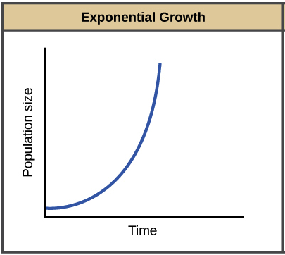
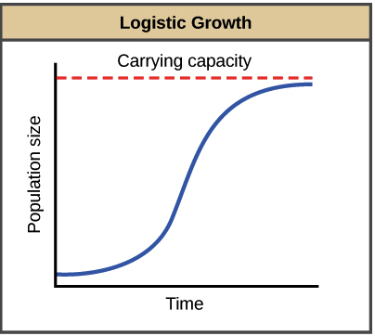
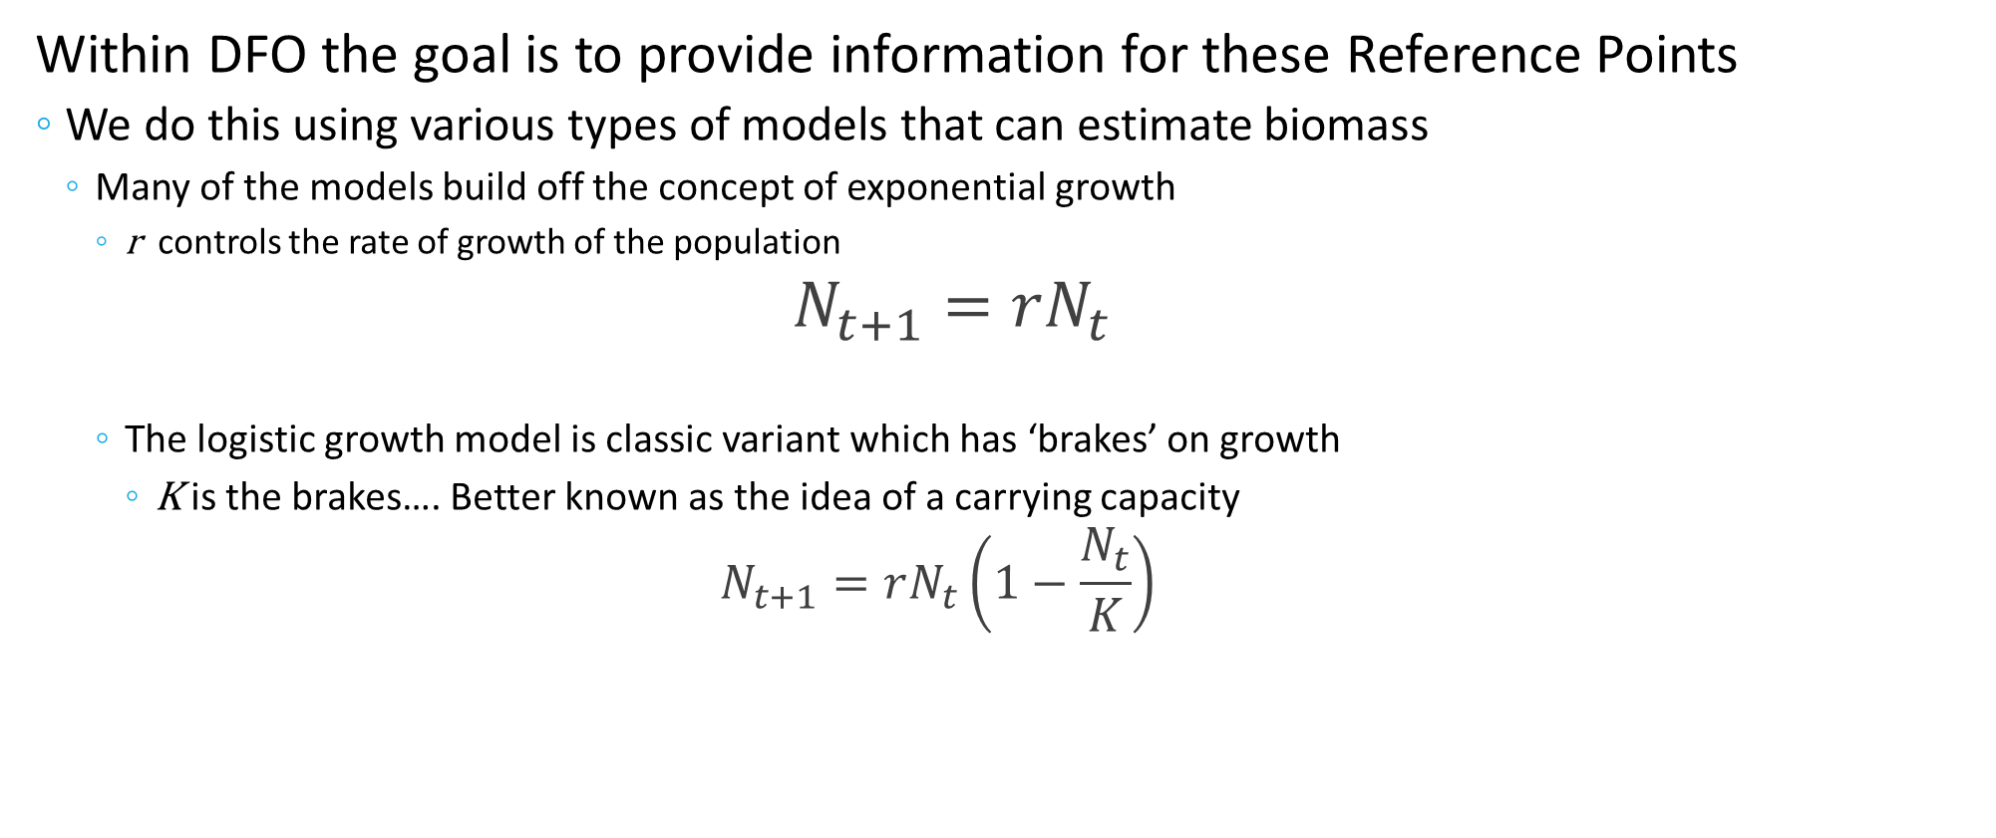
The Stock Assessment Model
Within DFO the goal is to provide information for these Reference Points
We do this using various types of models that can estimate biomass
Many of the models build off the concept of exponential growth
r controls the rate of growth of the population
$$N_{t+1}=rN_{t}$$
The logistic growth model is classic variant which has ‘brakes’ on growth
K is the brakes…. Better known as the idea of a carrying capacity
$$N_{t+1}=rN_{t}\left(1−\frac{N_{t}}{K}\right)$$
Notes:
Four lecture topics are identified by red boxes
- People is in bold because there are direct implications of the science on the people that it impacts.

Slide 9
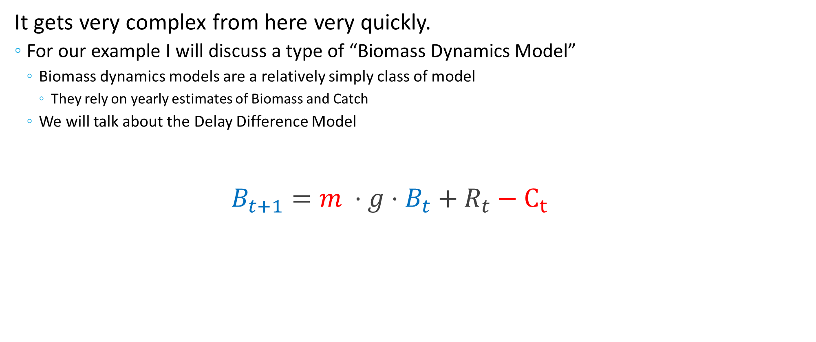
The Stock Assessment Model
It gets very complex from here very quickly.
For our example I will discuss a type of “Biomass Dynamics Model”
Biomass dynamics models are a relatively simply class of model
They rely on yearly estimates of Biomass and Catch
We will talk about the Delay Difference Model
$$B_{t+1}={m ⋅g⋅B}_{t}+R_{t}−C_{t}$$
Current
biomass
Catch from fishery(s)
Next year
biomass
≈ r , K
split into components
Notes:
Four lecture topics are identified by red boxes
- People is in bold because there are direct implications of the science on the people that it impacts.

Slide 10


The Stock Assessment Model
$$B_{t+1}={m ⋅g⋅B}_{t}+R_{t}−C_{t}$$
$$B_{t+1} ={ B}_{t} + G_{t} +{ R}_{t} − M_{t} −{ C}_{t}$$
Next year biomass
Account balance next year
Current biomass
Growth
Recruitment
Natural Mortality
Fishery catch
Current balance
Interest
Income
Basic expenses
Surplus $$
Notes:
Four lecture topics are identified by red boxes
- People is in bold because there are direct implications of the science on the people that it impacts.

Slide 11
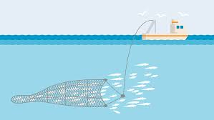
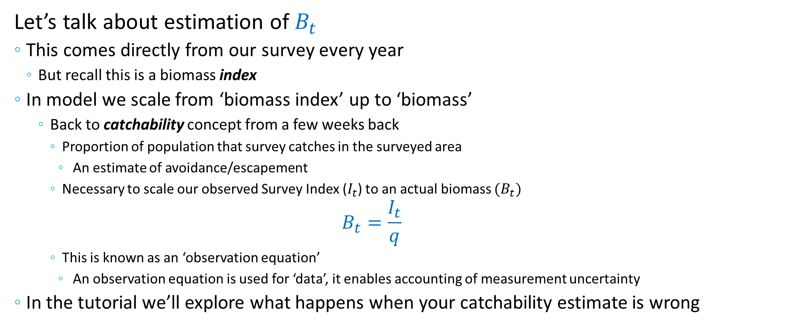
The Stock Assessment Model
$$B_{t+1}={m ⋅g⋅B}_{t}+R_{t}−C_{t}$$
Let’s talk about estimation of $B_{t}$
This comes directly from our survey every year
But recall this is a biomass index
In model we scale from ‘biomass index’ up to ‘biomass’
Back to catchability concept from a few weeks back
Proportion of population that survey catches in the surveyed area
An estimate of avoidance/escapement
Necessary to scale our observed Survey Index ($I_{t}$) to an actual biomass ${(B}_{t})$
$$B_{t}=\frac{I_{t}}{q}$$
This is known as an ‘observation equation’
An observation equation is used for ‘data’, it enables accounting of measurement uncertainty
In the tutorial we’ll explore what happens when your catchability estimate is wrong
Trawl
Notes:
Four lecture topics are identified by red boxes
- People is in bold because there are direct implications of the science on the people that it impacts.

Slide 12
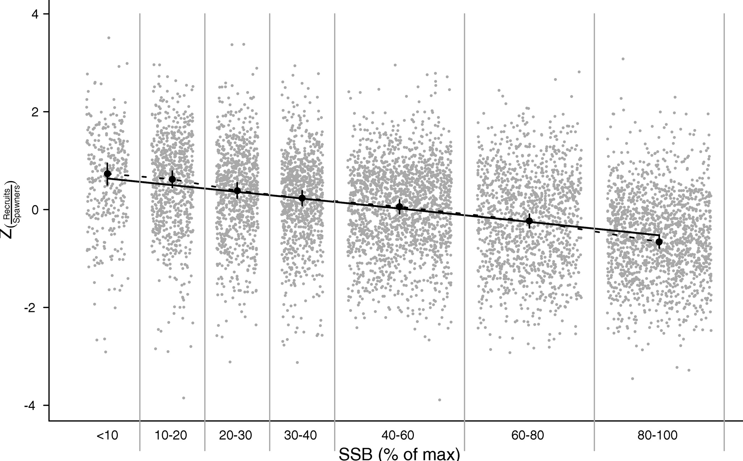
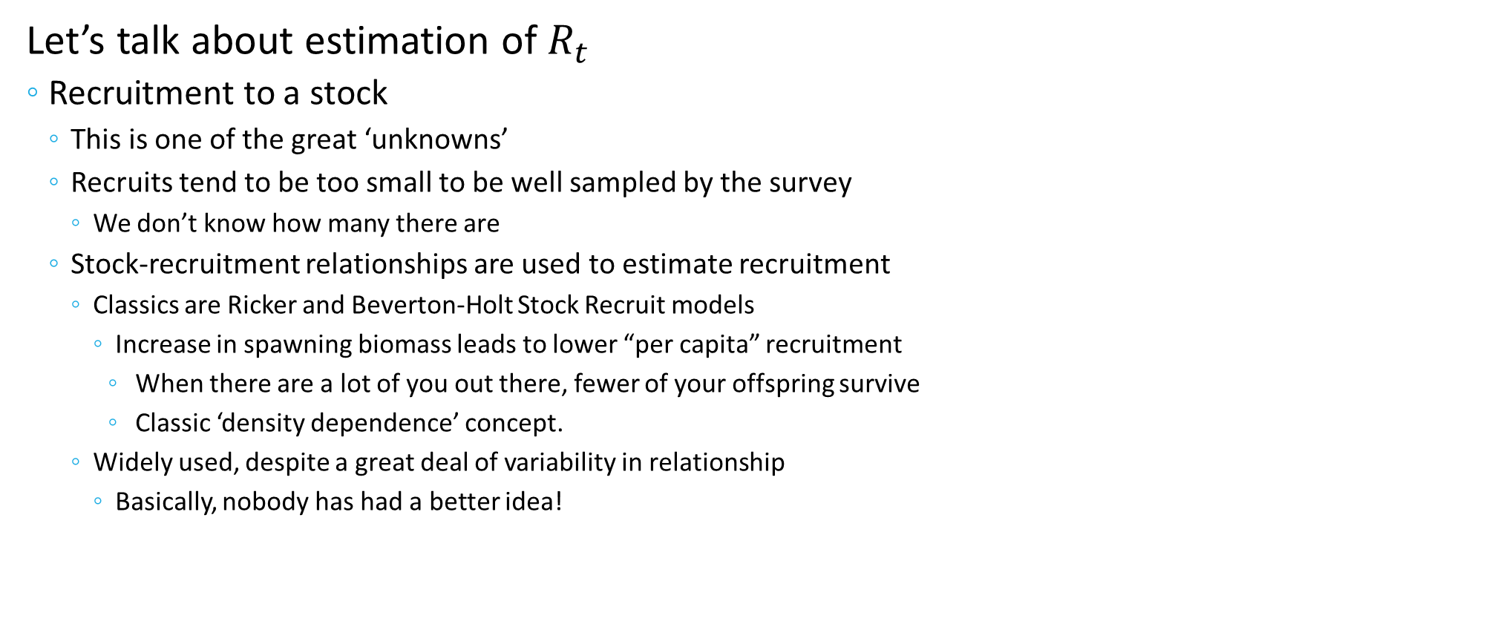
The Stock Assessment Model
$$B_{t+1}={m ⋅g⋅B}_{t}+R_{t}−C_{t}$$
Let’s talk about estimation of $R_{t}$
Recruitment to a stock
This is one of the great ‘unknowns’
Recruits tend to be too small to be well sampled by the survey
We don’t know how many there are
Stock-recruitment relationships are used to estimate recruitment
Classics are Ricker and Beverton-Holt Stock Recruit models
Increase in spawning biomass leads to lower “per capita” recruitment
When there are a lot of you out there, fewer of your offspring survive
Classic ‘density dependence’ concept.
Widely used, despite a great deal of variability in relationship
Basically, nobody has had a better idea!
Notes:
Four lecture topics are identified by red boxes
- People is in bold because there are direct implications of the science on the people that it impacts.

Slide 13
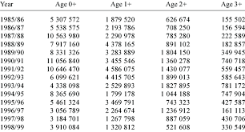
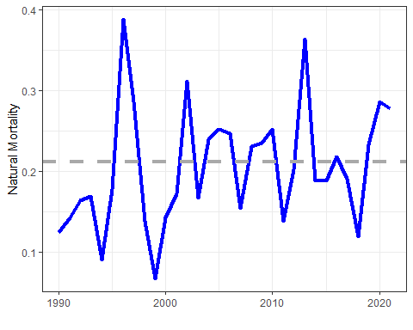
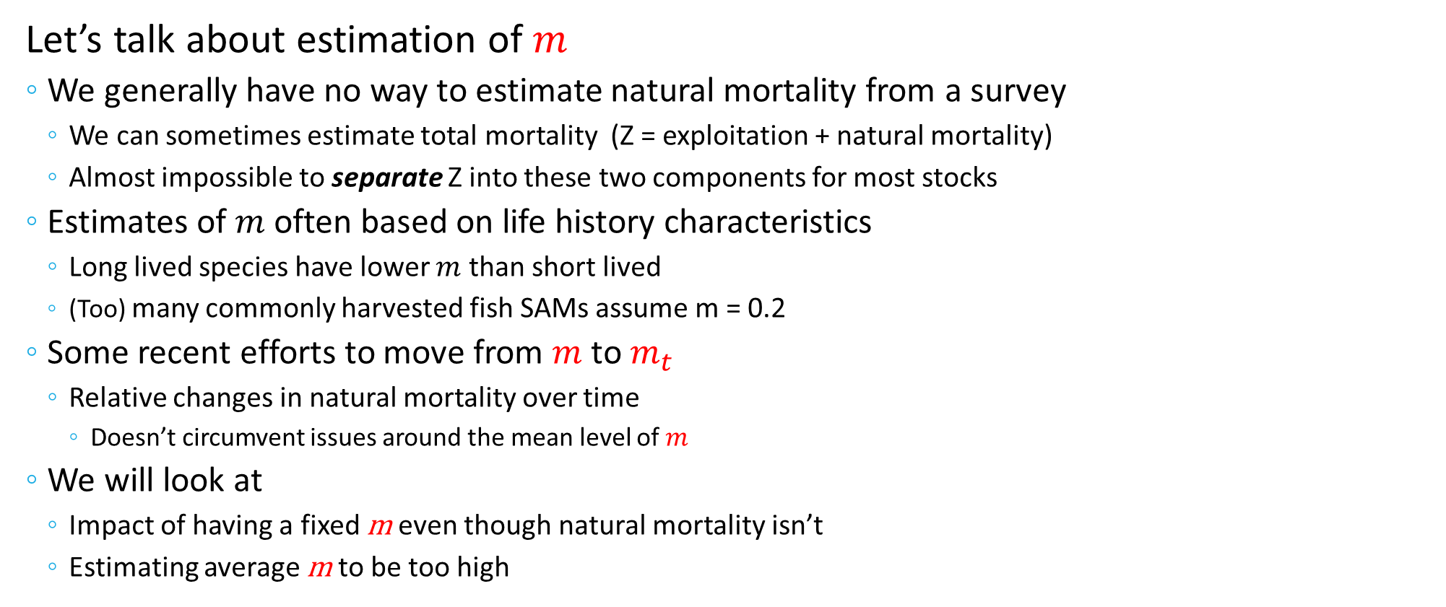
The Stock Assessment Model
$$B_{t+1}={m ⋅g⋅B}_{t}+R_{t}−C_{t}$$
Let’s talk about estimation of $m$
We generally have no way to estimate natural mortality from a survey
We can sometimes estimate total mortality (Z = exploitation + natural mortality)
Almost impossible to separate Z into these two components for most stocks
Estimates of $m$ often based on life history characteristics
Long lived species have lower $m$ than short lived
(Too) many commonly harvested fish SAMs assume m = 0.2
Some recent efforts to move from $m$ to $m_{t}$
Relative changes in natural mortality over time
Doesn’t circumvent issues around the mean level of $m$
We will look at
Impact of having a fixed m even though natural mortality isn’t
Estimating average m to be too high
Notes:
Four lecture topics are identified by red boxes
- People is in bold because there are direct implications of the science on the people that it impacts.

Slide 14
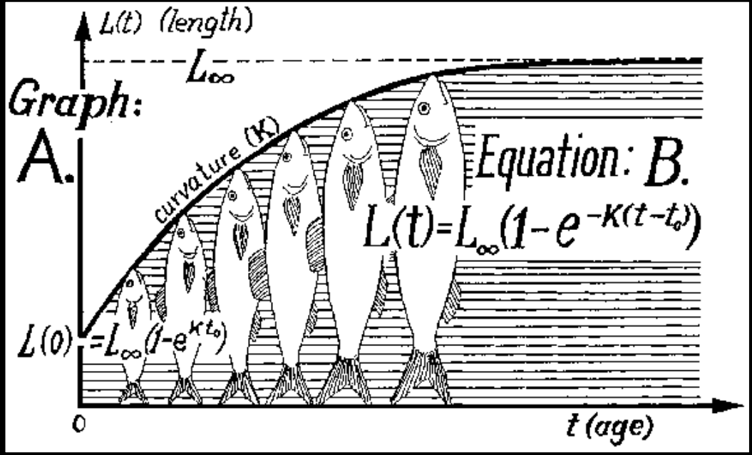
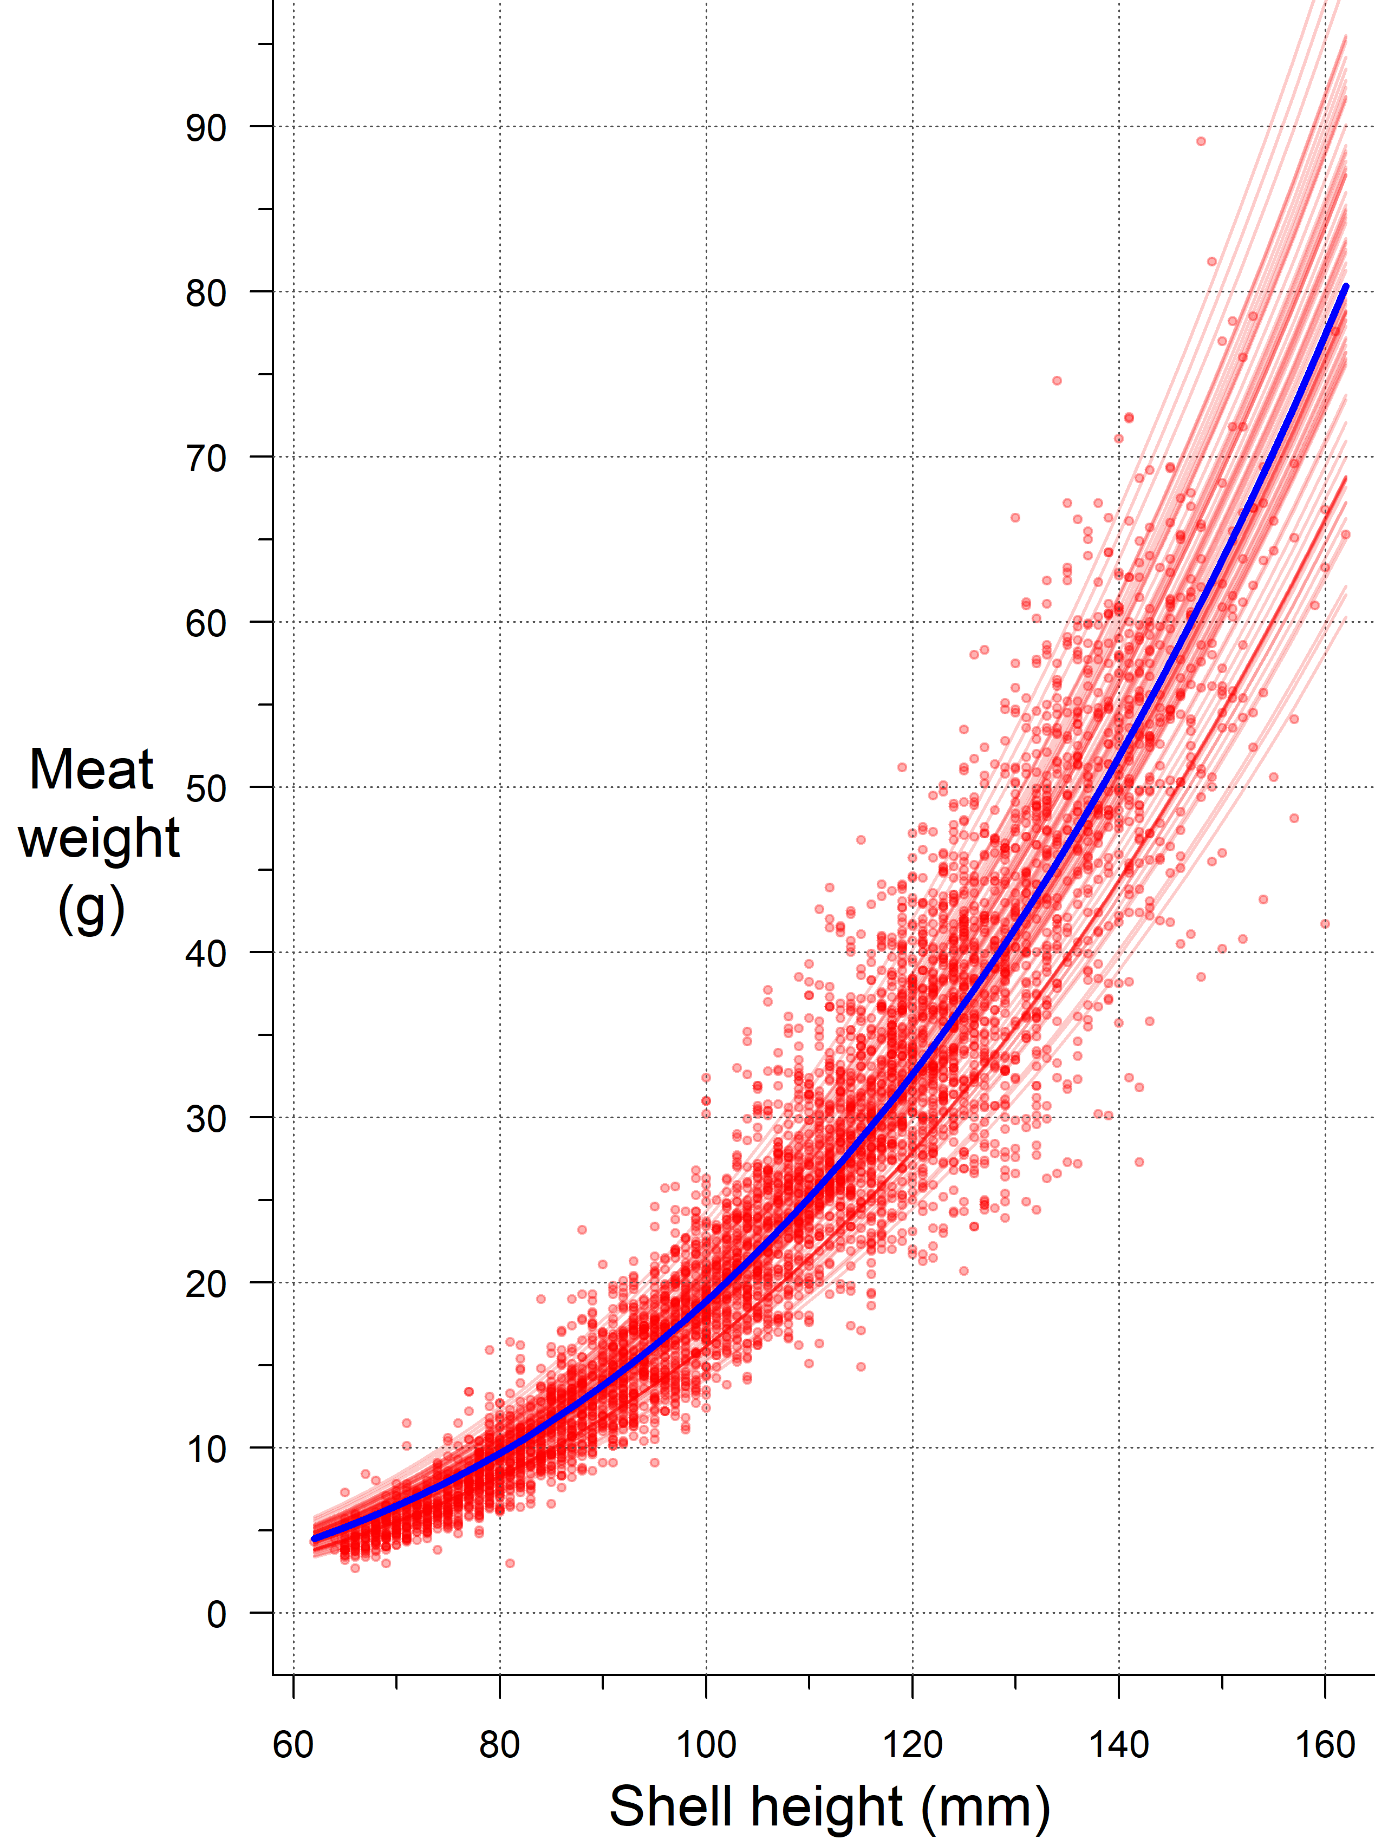
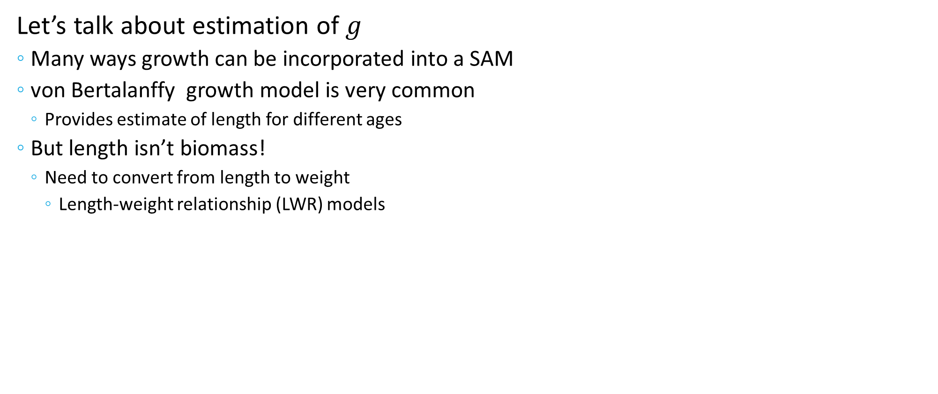
The Stock Assessment Model
$$B_{t+1}={m ⋅g⋅B}_{t}+R_{t}−C_{t}$$
Let’s talk about estimation of $g$
Many ways growth can be incorporated into a SAM
von Bertalanffy growth model is very common
Provides estimate of length for different ages
But length isn’t biomass!
Need to convert from length to weight
Length-weight relationship (LWR) models
Notes:
Four lecture topics are identified by red boxes
- People is in bold because there are direct implications of the science on the people that it impacts.

Slide 15
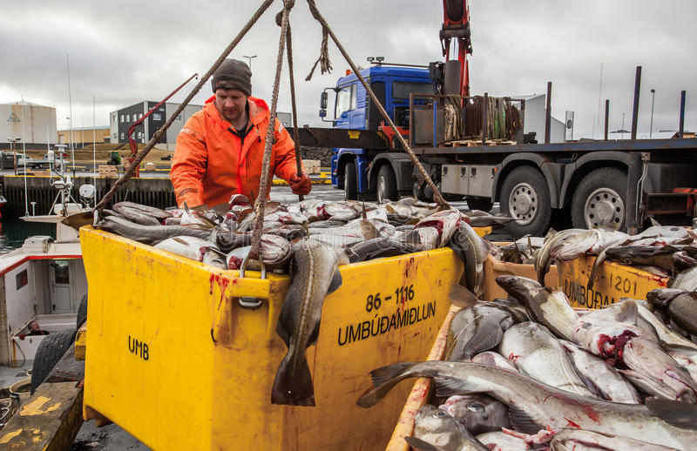
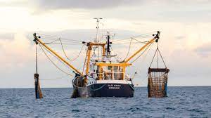
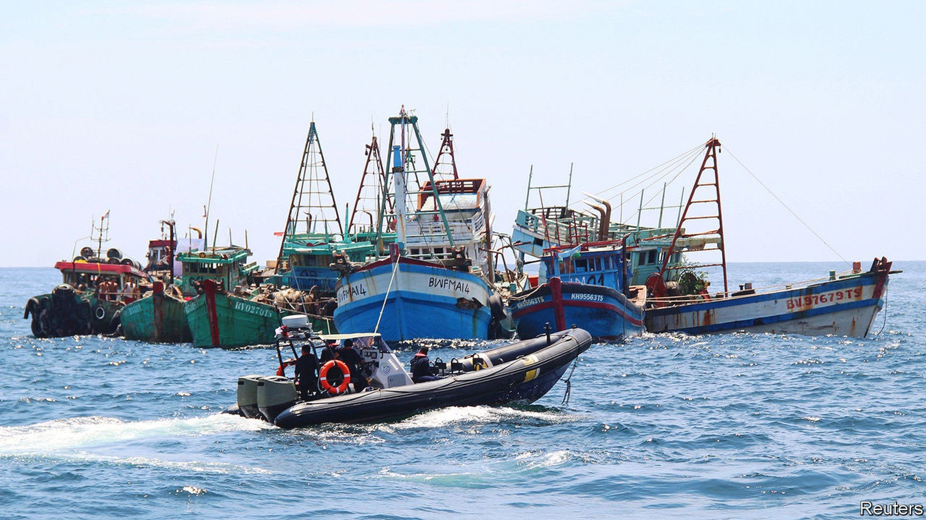
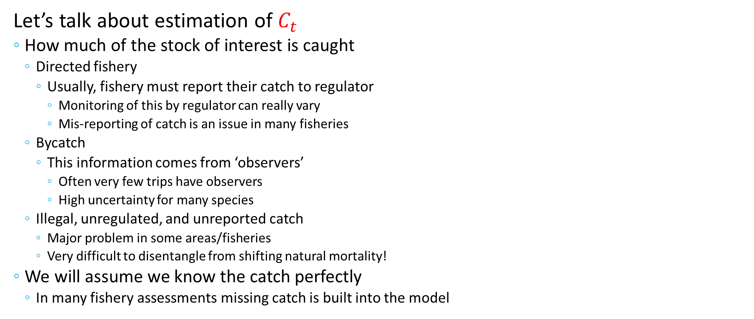
The Stock Assessment Model
$$B_{t+1}={m ⋅g⋅B}_{t}+R_{t}−C_{t}$$
Let’s talk about estimation of $C_{t}$
How much of the stock of interest is caught
Directed fishery
Usually, fishery must report their catch to regulator
Monitoring of this by regulator can really vary
Mis-reporting of catch is an issue in many fisheries
Bycatch
This information comes from ‘observers’
Often very few trips have observers
High uncertainty for many species
Illegal, unregulated, and unreported catch
Major problem in some areas/fisheries
Very difficult to disentangle from shifting natural mortality!
We will assume we know the catch perfectly
In many fishery assessments missing catch is built into the model
Notes:
Four lecture topics are identified by red boxes
- People is in bold because there are direct implications of the science on the people that it impacts.

Slide 16
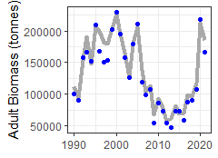
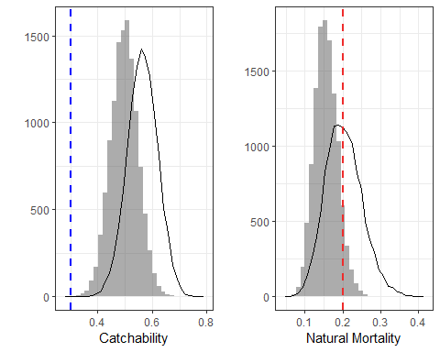
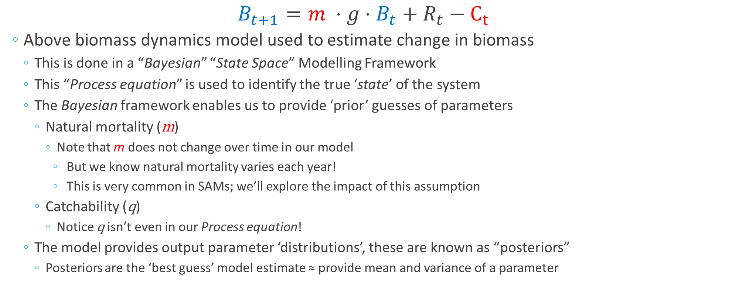
Tutorial SAM
$$B_{t+1}={m ⋅g⋅B}_{t}+R_{t}−C_{t}$$
Above biomass dynamics model used to estimate change in biomass
This is done in a “Bayesian” “State Space” Modelling Framework
This “Process equation” is used to identify the true ‘state’ of the system
The Bayesian framework enables us to provide ‘prior’ guesses of parameters
Natural mortality (m)
Note that m does not change over time in our model
But we know natural mortality varies each year!
This is very common in SAMs; we’ll explore the impact of this assumption
Catchability (q)
Notice q isn’t even in our Process equation!
The model provides output parameter ‘distributions’, these are known as “posteriors”
Posteriors are the ‘best guess’ model estimate ≈ provide mean and variance of a parameter
Notes:
Four lecture topics are identified by red boxes
- People is in bold because there are direct implications of the science on the people that it impacts.

Slide 17
Stock Assessment Tutorial
Greatly simplified this for this week, hopefully this works better!
We have 3 scenarios to consider
The model has been run with the correct prior estimates for catchability and mean natural mortality rate
The model has been run with incorrect prior estimates for catchability
The model has been run with incorrect prior estimates of mean natural mortality
In the Summary_of_results.docx the key results from the 3 cases. Questions to consider
How well does the model estimate the biomass when we have good estimates of parameters?
How does assuming that m is the same each year impact the model results?
What happens to the model biomass when our catchability estimate is higher than reality?
What are the implications of this for stock assessments in general?
What happens to model estimates of natural mortality? Why?
What happens to the model biomass when our natural mortality estimate is higher than reality?
What are the implications of this for stock assessments in general?
What happens to model estimates of catchability? Why?
Notes:
Four lecture topics are identified by red boxes
- People is in bold because there are direct implications of the science on the people that it impacts.

